Slide 1

Sport Analytics
Football Match Predictions
BI - 2
He NI
Bader GUETARI
Intervenants : FALIH, Issam

Slide 2
INTRODUCTION
Purpose of the project : analyse data around sport
Dataset chosen : soccer
Goals : - extract insights to understand efficiency of some teams
- predict the results of a match

Slide 3
Contents
01
Raw Data Introduction
02
Data pre-processing
03
Data Visualization
04
Match Predictions

Slide 4
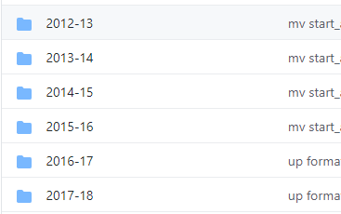
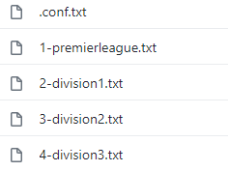
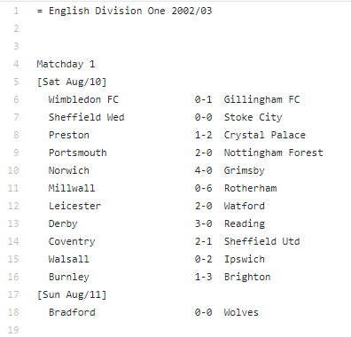
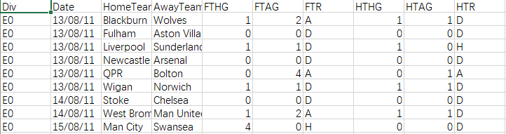
Raw Data Introduction
We have selected the soccer dataset
http://openfootball.github.io/
According to the image on the right, this dataset divides the match data by year and match level. Because of the large amount of data, we only extracted the premier league data for each year.
Step 1: Download eng2020-21.rb Datafile (from GitHub) to your working folder as ./Datafile
Step 2: Run the sportdb build command
Step 2.a: Download all datasets listed in the Datafile as zip archives (from GitHub) to ./tmp
Step 2.b: Create the "empty" database, that is, table structure, indexes, etc. (schema)
Step 2.c: Read in all datasets from the zip archives in ./tmp (no need to unpack)
Then we can get the can.csv file

Slide 5
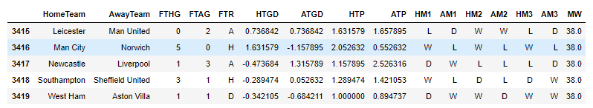
Data pre-processing
Feature explanation: HTGD,ATGD,HTP,ATP has already been divided by weeks and get the mean
FTHG & FTAG: Full Time Home/Away Team Goals
FTR: Full Time Result (H=Home Win, D=Draw, A=Away Win)
HTGD & ATGD: Till current match, home/away team goals difference.
Ex: For the row 3415, the hometeam Leicester get -2 goals difference in this match, and we add -2 to the previous Leicester goals difference(all past matches of Leicester) and divid it by weeks(38) and get the HTGD = 0.736842, same way with ATGD
HTP & ATP: Win = 3 point, Draw = 1 point, Lose = 0 point. Home/Away Team cumulative score as of the current competition week
HM123 & AM123: Represents the Home/Away Team's last 3 match win or loss.
MW：Weeks

Slide 6
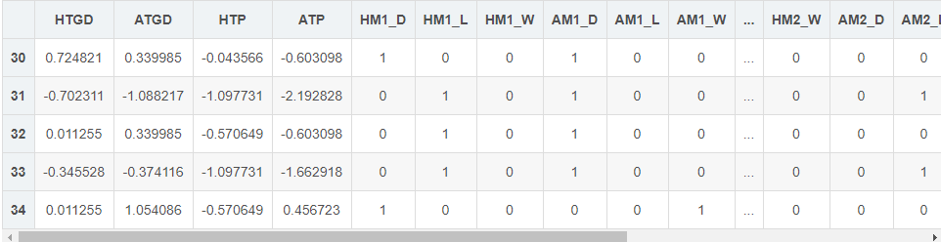
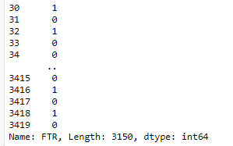

Data pre-processing
We use FTR as the label value, and if FTR=H, change it to 1
Else change it to 0.
Which means home team win =1 else consequence = 0
HTGD, ATGD, HTP, ATP, HM123, AM123 as the feature values
We do max-min normalization and normalization for HTGD, ATGD, HTP, ATP, and convert HM123 and AM123 to dummy coded features.

Slide 7
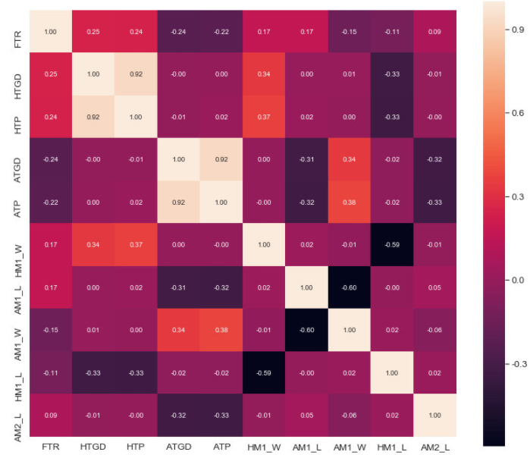
Data pre-processing
Then we generate correlation plots of some features to see the feature-to-feature correlation.
We look for the most relevant feature with FTP, the closer to 1, the greater the relevance, so the most relevant feature is HTGD

Slide 8
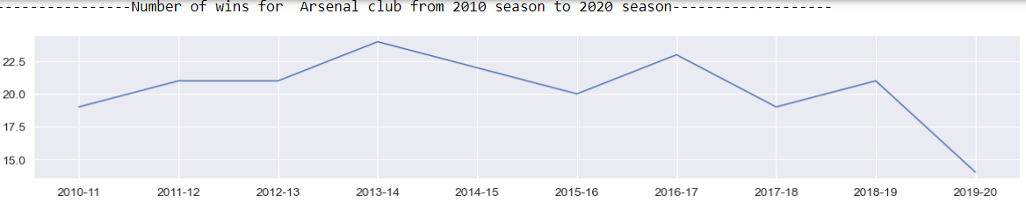
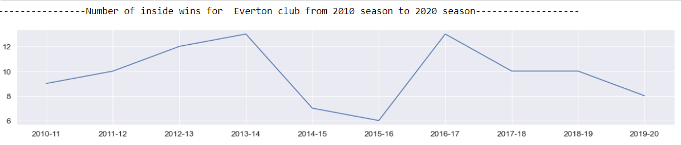
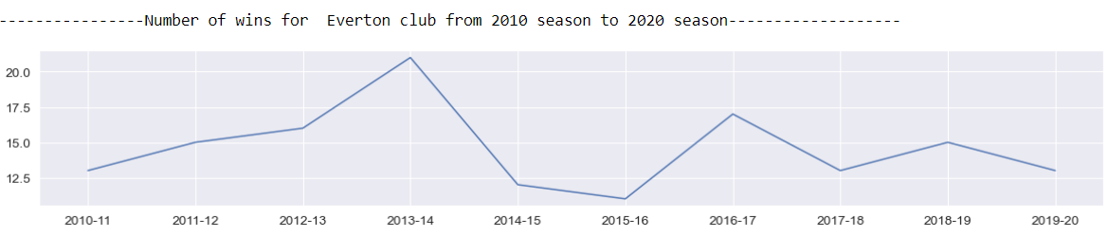
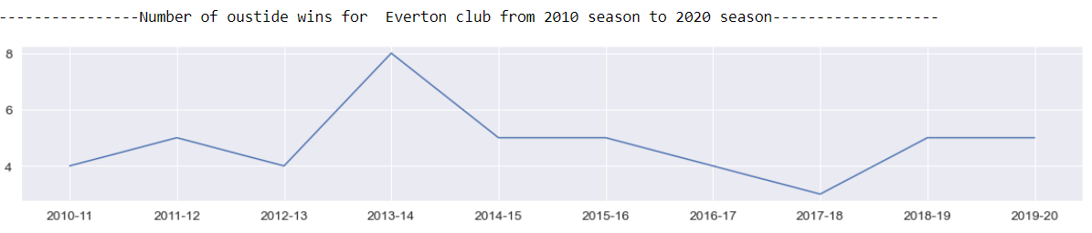
DATA VISUALIZATION
We can create some insights (how many wins per seasons ? Is a team more successful outside than inside ?)
We can also check others insights. For example, is a team more successful outside than inside. For Everton for example.
Winning rate inside :
Winning rate outside:

Slide 9
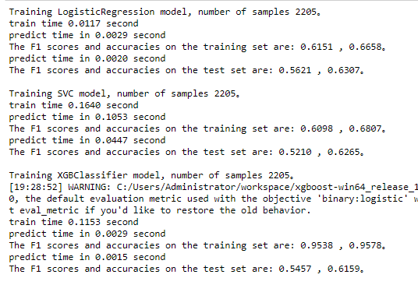
Match Predictions
We chose three prediction models, Logistic Regression, SVC and XGB Classifier.
We found that XGB Classifier performs very well in the training set, so we decided to use XGB Classifier and use Grid Search for tuning, and finally get the best model.

Slide 10
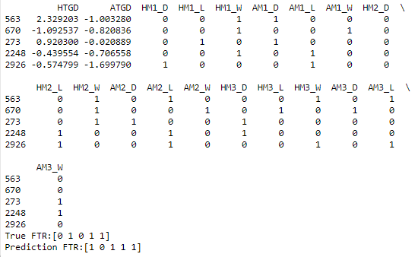
Match Predictions
Then we try to make a prediction, we choose 5 random data.
We get 5 True FTR:[0 1 0 1 1]
We get 5 Prediction FTR:[1 0 1 1 1]
So the accuracy of correction is 60%, as we predicted before, it is normal accuracy.

Slide 11
Conclusion
Interesting project
Working on every step of data processing in IT (data pre-processing, data visualization, machine learning...)
We can also find a good use of these analysis and predictions (to check the efficiency of some teams)

Slide 12

Thank you
he.ni@efrei.net
bader.guetari@efrei.net
http://openfootball.github.io/

